Slide 1
Chapter 21: Bipolar Junction Transistors (Part 1)
Basic Characteristics of BJT

Slide 2
Objectives
After completing Part 1 of this chapter, you will be able to:
Describe the basic structure of the Bipolar Junction Transistor (BJT).
Differentiate between NPN and PNP transistor.
Explain how a transistor is biased and analyse transistor currents and their voltages.
Differentiate between dc alpha and dc beta of a transistor.
Differentiate between active, cut-off and saturation regions of operation.

Slide 3
21-1 Transistor Structure
Bipolar Junction Transistor is a device constructed using 3 alternately doped semiconductor regions
The 3 regions are either P-N-P or N-P-N.
Hence BJT is either of PNP type or NPN type
Whichever the type, the 3 doped regions are called:
The Emitter (heavily doped)
The Base (thin layer that is lightly doped)
The Collector (moderately doped)
Each semiconductor region may carry a current

Slide 4
Transistor Structure
Both PNP and NPN BJTs also have 2 p-n junctions called
Base-Emitter junction
Base-Collector junction
Each junction of the BJT may carry a voltage

Slide 5
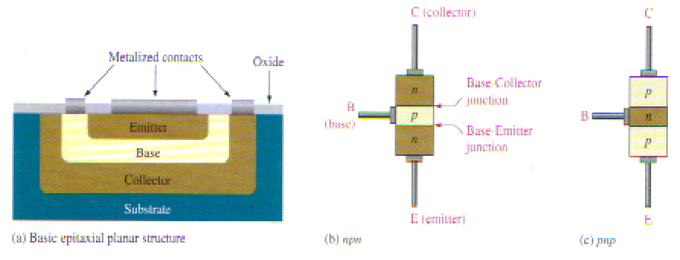
Transistor Structure
Bipolar Junction Transistor construction

Slide 6
Transistor Structure
Collector
Collector
Base
Base
Emitter
Emitter
NPN Transistor
PNP Transistor
Standard bipolar junction transistor symbols

Slide 7
21-2 Basic Transistor Operation
For a BJT to operate properly, its 2 p-n junctions must be connected to appropriate circuits
These circuits are said to “bias” the transistor

Slide 8
Basic Transistor Operation
In an NPN BJT, biasing is done as follows:
B-C reverse
biased
+
I_{C}
I_{C}
I_{B}
-
C (n jtn)
B (p jtn)
I_{B}
n
V_{CC}
p
+
E (n jtn)
n
V_{BB}
-
B-E forward
biased
I_{E}
Base-Emitter Biasing Circuit
Collector-Emitter Biasing Circuit

Slide 9
Basic Transistor Operation
In a PNP BJT, biasing is done in the reverse direction
B-C reverse
biased
-
I_{C}
I_{C}
I_{B}
+
C (p jtn)
B
(n jtn)
I_{B}
p
V_{CC}
n
-
E (p jtn)
p
V_{BB}
+
B-E forward
biased
I_{E}
Base-Emitter Biasing Circuit
Collector-Emitter Biasing Circuit

Slide 10
Basic Transistor Operation
In practice,
V_{CC} is usually taken directly from a power supply
V_{BB} is usually obtained from a voltage divider
I_{C}
I_{B}
V_{CC}
+
V_{BB}
-

Slide 11
Transistor Currents and Voltages
Definition of Currents and Voltages
R_{C}
I_{C}
R_{B}
V_{CB}
+
_
+
V_{CE}
V_{CC}
I_{B}
+
V_{BE _}
_
I_{B} : dc base current
V_{BB}
I_{E} : dc emitter current
I_{E}
I_{C} : dc collector current
V_{BE}: dc voltage at base with respect to the emitter
V_{CB}: dc voltage at collector with respect to the base
V_{CE}: dc voltage at collector with respect to the emitter

Slide 12
Transistor Currents and Voltages
I_{C}
If I_{B} and I_{C} are known:
I_{B}
I_{E} = I_{C} + I_{B}
NPN BJT
I_{E}
Note also that:
I_{C}
I_{C} >> I_{B}
I_{B}
PNP BJT
And
I_{E} ≅ I_{C}
I_{E}

Slide 13
21-3 Transistor Characteristics and Parameters
The ratio of I_{C} and I_{E} is called DC Alpha
And ratio of I_{C} and I_{B} is called DC Beta
DC Beta is also called h_{FE} in transistor data sheets
DC Alpha
α_{DC}
Typical values from 0.95 to 0.99 or higher but less than 1
DC Beta
β_{DC}
Typical values from 20 to 200 or higher

Slide 14
Transistor Characteristics and Parameters
DC Alpha and DC Beta are in turn related to each other as follows:
Relationship of β_{DC} and α_{DC}

Slide 15
Transistor Circuit Analysis
Base Emitter Circuit Analysis to find I_{B}
R_{C}
I_{C}
R_{B}
V_{CB}
+
_
+
V_{CE}
V_{CC}
I_{B}
+
V_{BE _}
_
Since V_{BE} is a forward biased p-n junction
V_{BB}
I_{E}
Using circuit analysis about BE Circuit,

Slide 16
Transistor Circuit Analysis
Collector Emitter Circuit Analysis to find I_{C}
R_{C}
I_{C}
R_{B}
V_{CB}
+
_
+
Using circuit analysis about CE Circuit,
V_{CE}
V_{CC}
I_{B}
+
V_{BE _}
_
V_{BB}
I_{E}
Recall also that
In addition, note that

Slide 17
Transistor Circuit Analysis
Example 21-1
Determine I_{B}, I_{C}, I_{E}, V_{BE}, V_{CE} and V_{CB} in the circuit below. The transistor has a β_{DC} of 150
R_{C}
120 Ω
R_{B}
V_{CC}
12 V
+
10 kΩ
V_{BB}
4 V
+

Slide 18
Transistor Circuit Analysis
R_{C}
120 Ω
Solution
R_{B}
+
V_{CC}
12 V
V_{BE} = 0.7 V
V_{BB}
4 V
10 kΩ
+
Using
I_{E} = I_{C} + I_{B} = 49.5 mA + 0.33 mA = 49.83 mA

Slide 19
Transistor Circuit Analysis
R_{C}
120 Ω
Solution
R_{B}
+
V_{CC}
12 V
V_{BB}
4V
10 kΩ
+

Slide 20
Collector Characteristic Curves
A Collector Characteristic Curve governs the relationship between I_{C} and V_{CE}
As V_{CC} increases, I_{C} and V_{CE} will also increase.
I_{C}
R_{C}
I_{C}
V_{CB}
+
+
V_{CC}
_
R_{B}
_
+
V_{CE}
+
V_{BB}
_
+
_
I_{B}
V_{BE}
_
I_{E}
0
V_{CE}
0.2V or 0.3V
V_{CE(max)}
I_{C} vs. V_{CE} curve for one value of I_{B}

Slide 21
Collector Characteristic Curves
Operating Regions of a Transistor
I_{C}
Saturation region
Breakdown region
Active region
V_{CE}

Slide 22
Collector Characteristic Curves
Family of I_{C} vs V_{CE} curves for different values of I_{B}
I_{C}
I_{B4}
I_{B3}
I_{B1} < I_{B2} < I_{B3}
I_{B2}
I_{B1}
I_{B}=0
I_{CEO}
V_{CE}
0
Cutoff region

Slide 23
Collector Characteristic Curves
Transistors can be operated in:
The cut-off region
The active region (linear region)
The saturation region
They should, however, NEVER be operated in the breakdown region

Slide 24
Operation in Cut-off Region
When I_{B} = 0 or very small (V_{BE}<0.7V), transistor is in the cut-off region
A very small amount of collector leakage current I_{CEO} (usually ignored) is present
R_{C}
I_{CEO}
R_{B}
+ V_{CC}
_
+
V_{CE(cut-off)}
_
I_{B} = 0
Since
Transistor C-E circuit acts like an open switch
V_{CE (cutoff)} ≈ V_{CC}
Hence,

Slide 25
Operation in Saturation Region
If I_{B} is increased further, transistor reaches SATURATION.
R_{C}
I_{C}
+
V_{CC}
_
R_{B}
+
V_{CE( SAT)}
+
V_{BB}
_
_
At saturation, I_{C} cannot increase further regardless of increases in I_{B}
I_{B}
When I_{B} = I_{B(sat)}, I_{C} = I_{C(sat)}
Then V_{CE} = V_{CE(sat)} = 0.2 or 0.3 V
Transistor C-E circuit acts like an closed switch

Slide 26
Operation in Active Region
As I_{B} increases, I_{C} also increases and V_{CE} drops.
This is now the ACTIVE region of the BJT
In active region, relationship between I_{C} and V_{CE} are governed by the following equations:
OR
This equation shows how I_{C} is related to V_{CE} and is sometimes called the DC Load Line

Slide 27
Operation in Active Region
Transistor operating in Active Region acts like an amplifier
Here I_{C} = βI_{B}
We have already covered this mode of operation in the previous block

Slide 28
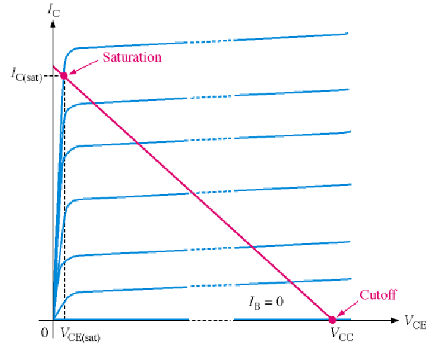
Operation in Active Region
DC Load Line
Active Region
Active region lies between the saturation and cut-off points.

Slide 29
Summary
The BJT (bipolar junction transistor) is constructed with three regions: base, collector, and emitter.
The BJT has two pn junctions
the base-emitter junction and
the base-collector junction.
Current in a BJT consists of both free electrons and holes, thus the term bipolar.
The base region is very thin and lightly doped compared to the collector and emitter regions.
The two types of bipolar junction transistor are the npn and the pnp.

Slide 30
Summary
The 3 currents in the transistor are the base current (I_{B}), emitter current (I_{E}), and collector current (I_{C}).
I_{B} is very small compared to I_{C} and I_{E}.
The dc current gain of a transistor is the ratio of Ic to I_{B} and is designated β_{DC}. Values typically range from less than 20 to several hundred.
β_{DC} is usually referred to as h_{FE} on transistor data sheets.
The ratio of I_{C} to I_{E} is called α_{DC} . Values typically range from 0.95 to 0.99.
A transistor can operate in the cut-off, active and saturation regions.

Slide 31
End of Chapter 21 (Part 1)

